Slide 1

Carbon neutral or low emissions livestock production
28 July 2023
Richard Eckard
Primary Industries Climate Challenges Centre
University of Melbourne

Slide 2
Who is asking for low emissions production?

Slide 3
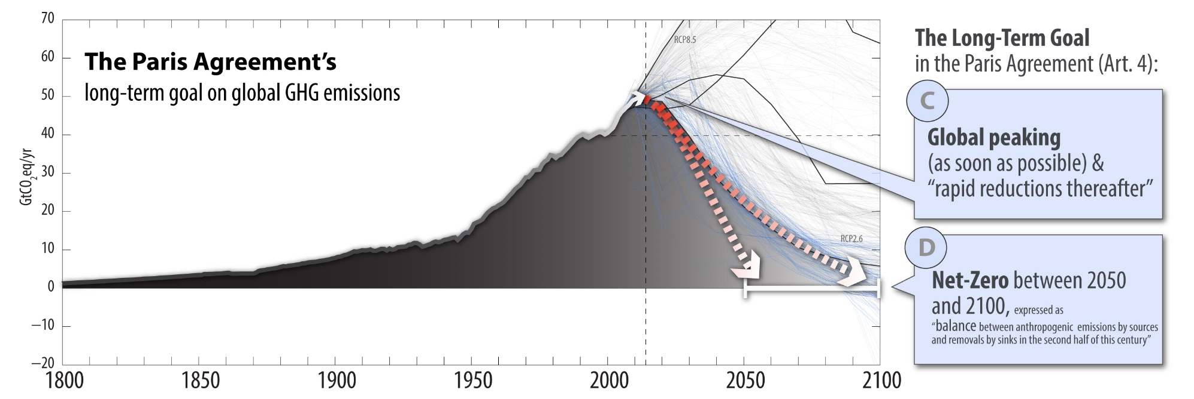
COP21 Paris Agreement
Reach global peaking GHG emissions as soon as possible
  Achieve a balance between anthropogenic emissions by sources and removals by 2050
  COP26 - Increased 2030 ambition
To meet 1.5 ⁰C, methane must reduce by
- 11-30% by 2030
- 24-47% by 2050
(Arndt et al. 2022)
Source: Malte Meinshausen 2015

Slide 4
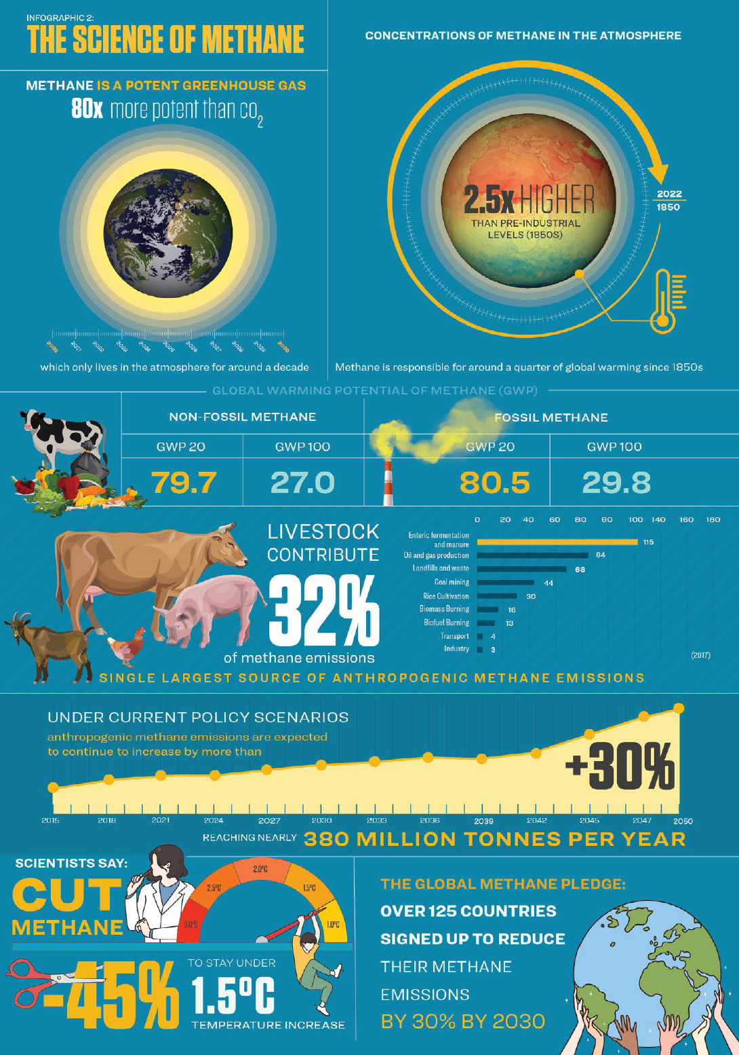
An alarming and growing disconnect
Industry bodies
  Emissions intensity targets
  Arguing for lesser targets for methane
    GWP* vs GWP100
    Biogenic vs fossil methane
    Climate neutral vs carbon neutral
International policy
  Key policy lever to avoid 1.5⁰ overshoot
  Binding methane reduction targets (e.g. NZ)
  Separate methane reduction targets (e.g. NZ)
  Reduce animal numbers in line with a just transition policy for the transformation of the animal agriculture sector
www.changingmarkets.org; www.iatp.org

Slide 5
Supply chain responses to Paris Agreement
Fonterra
  Climate-neutral growth to 2030 for pre-farmgate emissions from a 2015 base year
Unilever **
  Reducing the GHG impact of their products by 50% by 2030, compared to baseline of 2010
Mondelez
  Reduce absolute GHG from manufacturing 15%
  100% renewable energy
Nestle **
  Zero environmental impact in our operations
JBS
  Net-zero GHG by 2040 and zero deforestation across its global supply chain by 2035
Heineken
  Carbon neutral barley-malt supply chain
Rabobank & NAB
  Net zero financed emissions by 2050
  Hold 50% of Australia agri-debt market
Mars
  Reduce GHG across our value chain 27% by 2025 and 67% by 2050 (from 2015 levels)
Kellogg Company **
  65% reduction by 2050
  100% renewable energy
Pfizer
  60 to 80% by 2050
Wilmar international
  89.72% less GHG from 2013 to 2020
  100% renewable energy
Olam
  Reduce GHGs by 50% by 2030 both in our own operations and in our supply chain
  By 2050, we aspire to be carbon positive in operations, requiring a 5% emissions reduction per year from 2031 – 2050
** committed to increasing plant-based protein
Of the 100 largest economies 69 are companies and 31 are countries
70% of Australian farm produce is exported
Government policy may now be less influential than market forces
Source: Company sustainability reports https://oxfamapps.org/fp2p/the-worlds-top-100-economies-31-countries-69-corporations/

Slide 6
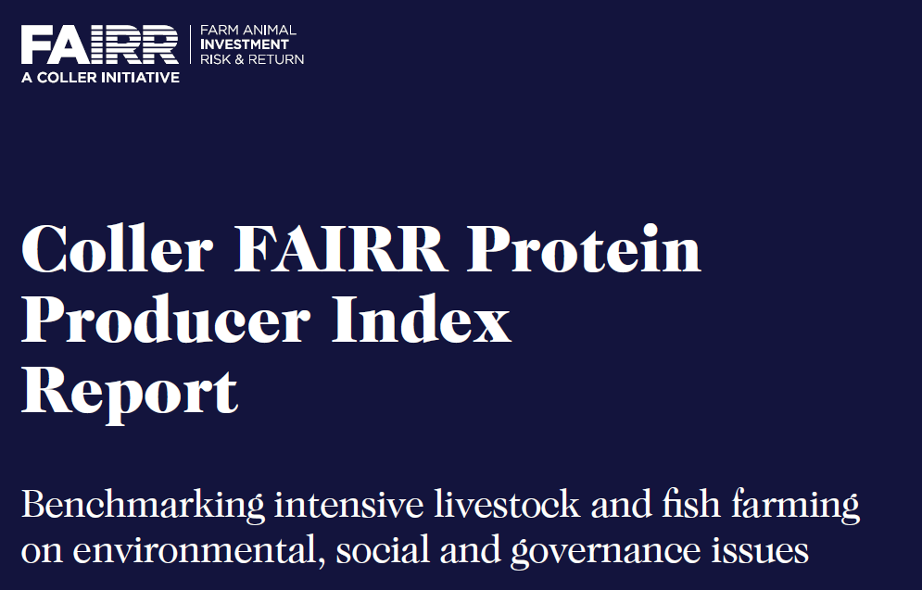
Industry and market drivers: investor responses
Good
Poor
FAIRR – an index of livestock production against the Sustainable Development Goals (SDGs).
A resource for institutional investors on risk of investment in livestock.
Source: Figure 3: FAIRR Index League Table (all factors); final company scores (out of 100)

Slide 7
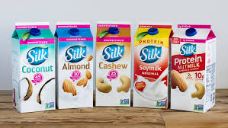
Industry and market drivers: potential impact on dairy
Danone purchased SILK/Whitewave (2017)
  $12.5B Silk brands
    ″A perfect match to build a global leader leveraging consumer trends and expectations for healthier and more sustainable eating and drinking choices,” - CEO Danone.
Eden Brew
  Norco Co-Op & CSIRO
    Milk from precision fermentation (Casein without the cow)
    “We use a fraction of the water, a fraction of the land. There’s no methane emissions from animals and no pollution into the water systems.” – CEO Eden Brew.
These may not take over BUT
  The words used in marketing should be a concern to dairy!

Slide 8
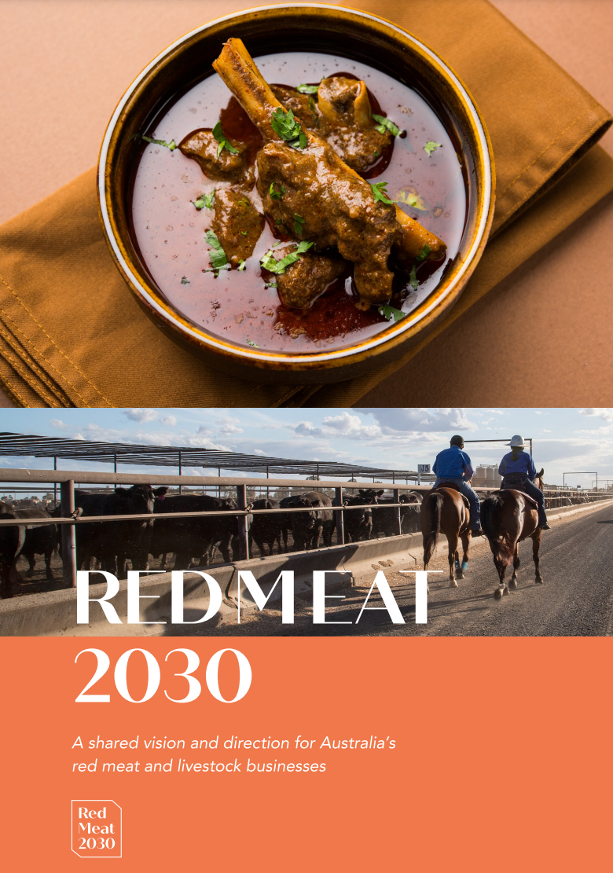

Industry and market drivers: livestock industry responses
Australian Red Meat Industry (RMAC 2030 strategy)
  Australian red-meat can be carbon (climate?) neutral by 2030 (CN30)
Mato Grosso do Sul, “MS carbon neutral” initiative
New Zealand
  Net zero by 2050
  Non-zero methane target
    Up to 47% by 2050
  All farms required to complete a carbon audit by 2022
    Research levy on methane
California SB 32
  40 % less methane by 2030 over 1990
Global Methane Pledge at COP26
  30% less methane by 2030 by 105 countries (plus Australia)

Slide 9
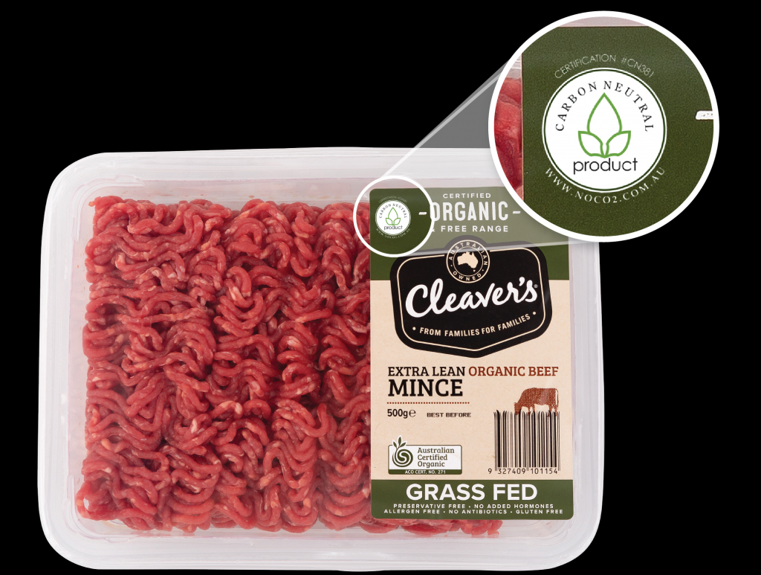
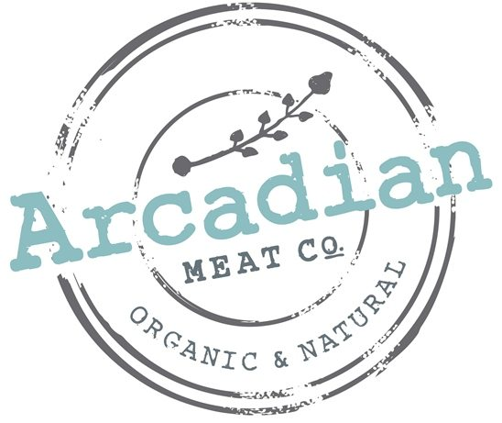



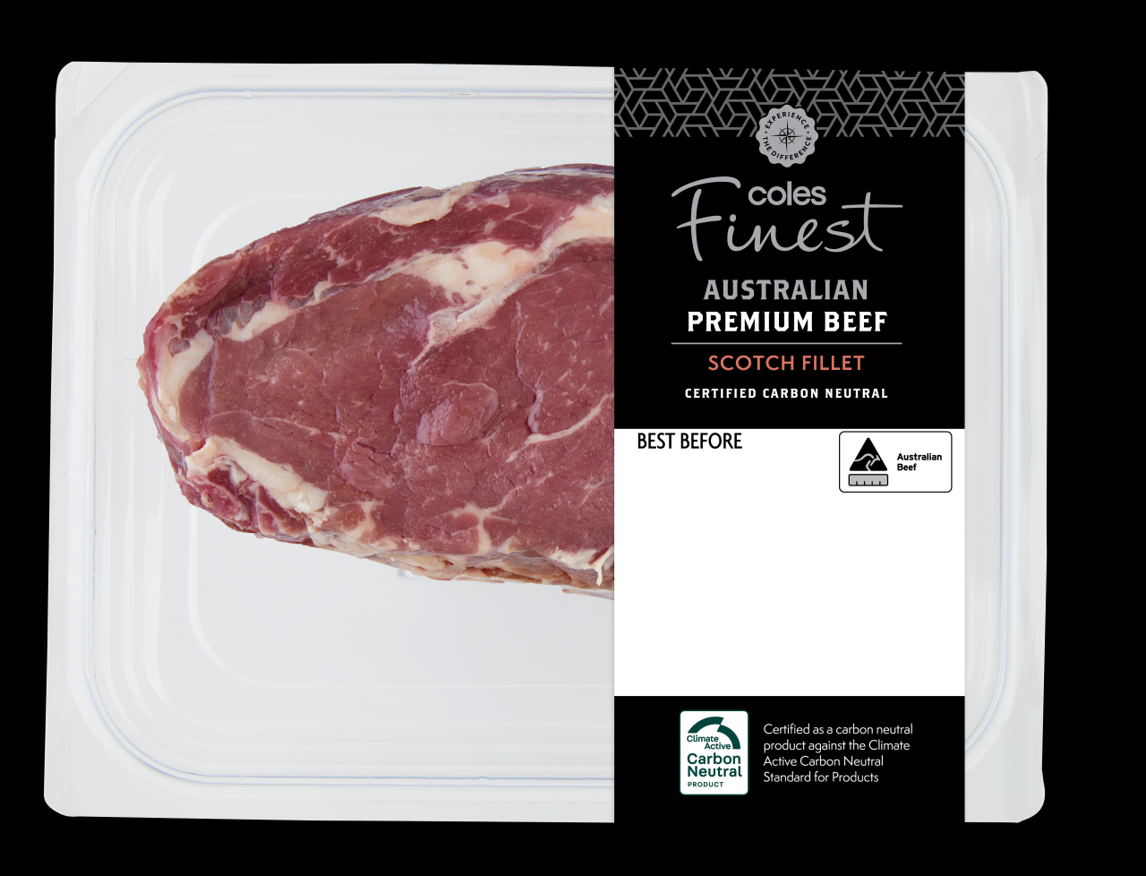


Industry and market drivers: carbon neutral agriculture
Livestock
  Arcadian Organic & Natural’s Meat Co’s
  Flinders + Co Meats
  NAPCO
  COLES
Wine
  Ross Hill
  Tulloch
  Cullen

Slide 10


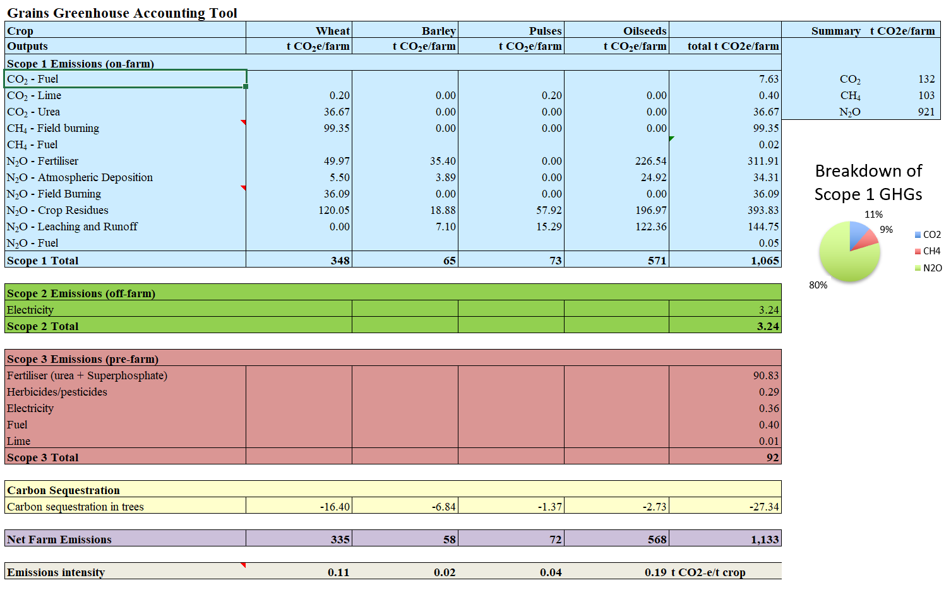
How will the supply chain achieve their targets?
Supply chains will need to meet their targets
All suppliers will conduct GHG audit
  Data sent to supply chain buyer
Purchaser starts buying at lowest GHG intensity
  The higher GHG they purchase costs them more carbon offsets
t CO₂e/t LWT
8 10 12 15 18 20 22 25

Slide 11

Key conclusion from Net Zero Australia plan
Agriculture will need to inset ALL their own soil and tree carbon
  Maintain supply chain access post 2030
There are no surplus offsets in agriculture!
Planting ALL wheat land in WA, will provide the NW-WA mining industry with max 50% offset for 25 years – but the wheat industry is gone

Slide 12
Marketing carbon neutral or carbon credits
To 2030
  Access to premium markets
    e.g. carbon neutral wool
Post 2030
  Future compliance with supply chain targets
    Insetting not offsetting
  Carbon credits only allowed in
    “hard to abate” sectors
Fundamental difference between
  Carbon sequestration offset
    Finite accumulating stock
    Will need these stocks as an INSET
  Emissions avoidance offset = flux
    Could sell these up to the day neutrality is required

Slide 13
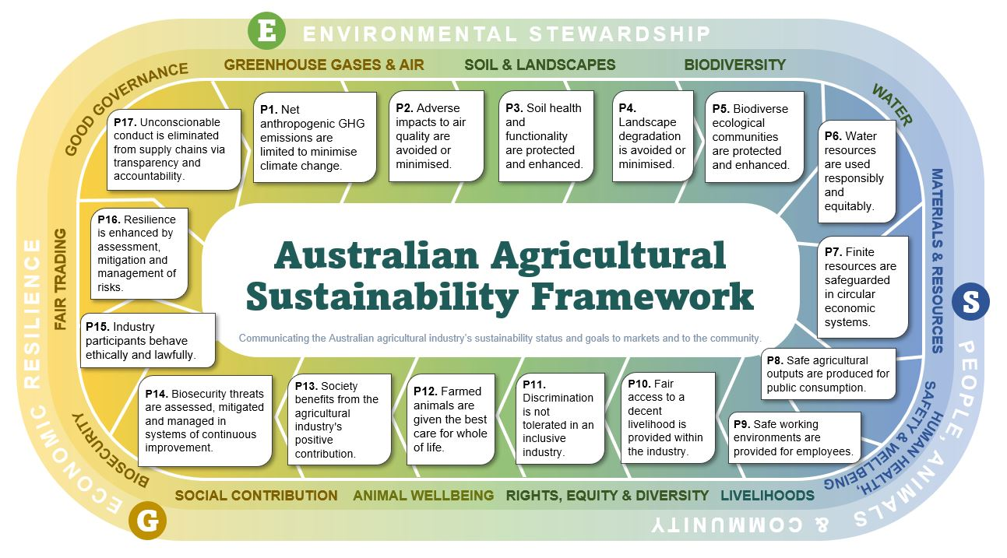
The Australian Agricultural Sustainability Framework
https://www.farminstitute.org.au/the-australian-agricultural-sustainability-framework/

Slide 14
What are the emissions from various agricultural systems?

Slide 15
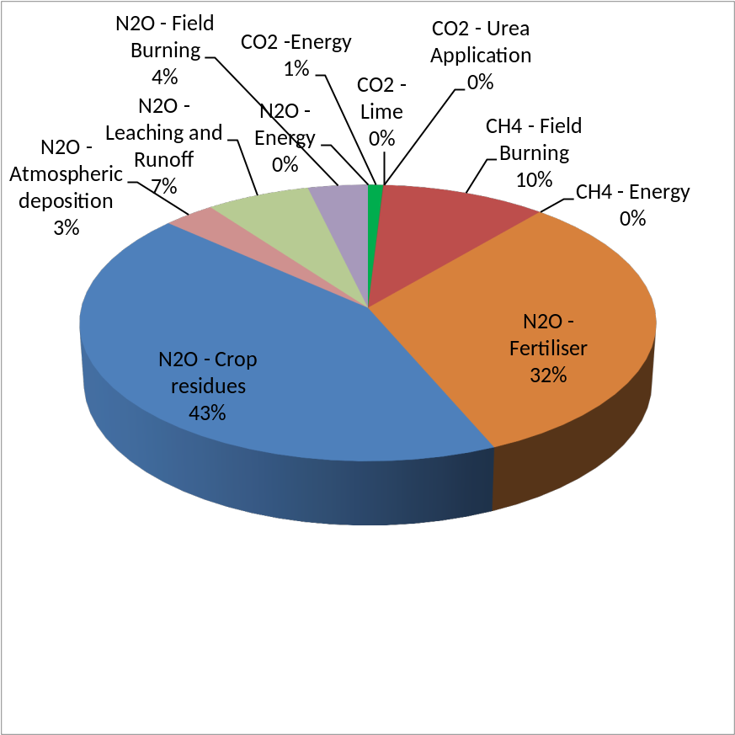
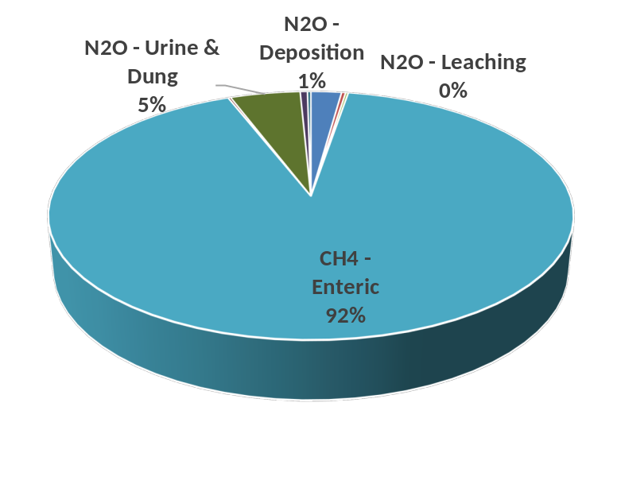
Greenhouse Gas Emissions: typical farm GHG Profiles
Dairy
Rangeland Beef
Grains / pulses
Christie et al. 2016

Slide 16
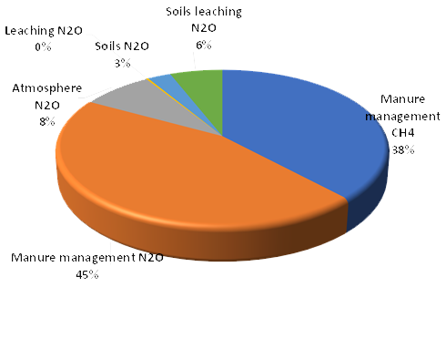
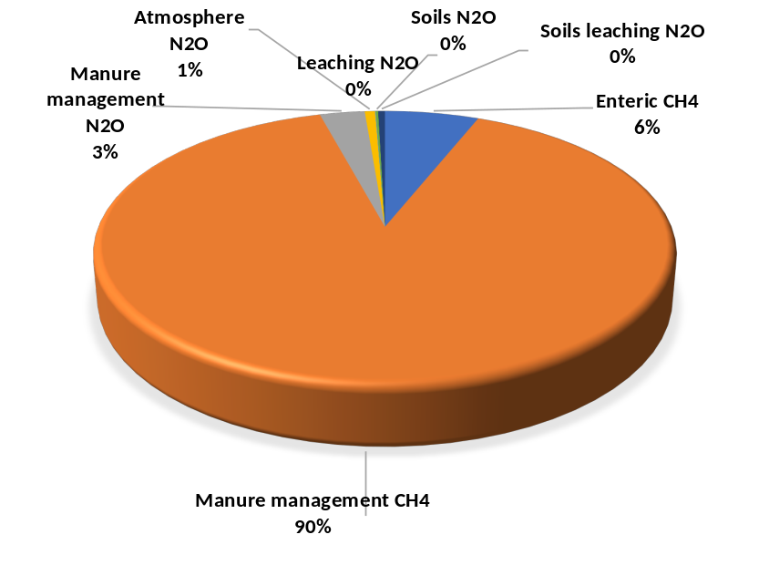
Greenhouse Gas Emissions: typical farm GHG profiles
Poultry
Pigs
Cotton
Vineyard and Wine
Abbott et al.(2016); Eckard et al. (2022)

Slide 17
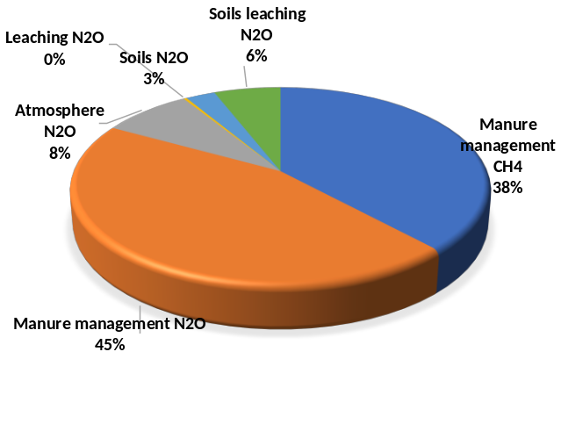
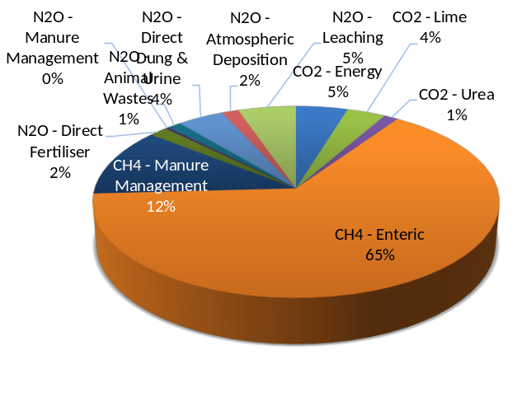
Emission Intensity - comparisons
Poultry
Chicken meat
  3 to 5 kg CO₂e/kg LWT
Pigs
  4 to 7 kg CO₂e/kg LWT
Grain production:
  0.1 to 0.5 kg CO₂e/kg grain
Dairy
  8 to 21 t CO₂e/t MS
Beef:
  11 to 18 kg CO₂e/kg LWT
Sheep:
  6 to 8 kg CO₂e/kg LWT
Wool:
  21 to 28 kg CO₂e/kg wool
Wine:
  0.6 to 4.68 kg CO₂e/L
Grains
Dairy
Vineyard & Wine
  Wiedeman et al. (2015); Browne et al. (2011); Alvarez-Hess et al. (2019); Abbott et al. (2016); Amienyo et al. 2014

Slide 18
Potential for net zero?
Chicken meat
  3 to 5 kg CO₂e/kg LWT
Pigs
  4 to 7 kg CO₂e/kg LWT
Grain production:
  0.1 to 0.5 kg CO₂e/kg grain
Dairy
  8 to 21 t CO₂e/t MS
Beef:
  11 to 18 kg CO₂e/kg LWT
Sheep:
  6 to 8 kg CO₂e/kg LWT
Wool:
  21 to 28 kg CO₂e/kg wool
Wine:
  0.6 to 4.68 kg CO₂e/L
Pigs and poultry
  Manure management
  Renewable energy
Dairy and feedlots
  50% is possible
Extensive grazing
  10-20% may be possible
Wine & perennial hort
  100% achievable
Annual cropping
  50% possible but
  Wiedeman et al. (2015); Browne et al. (2011); Alvarez-Hess et al. (2019); Abbott et al. (2016)

Slide 19
How do we account for carbon neutrality?

Slide 20
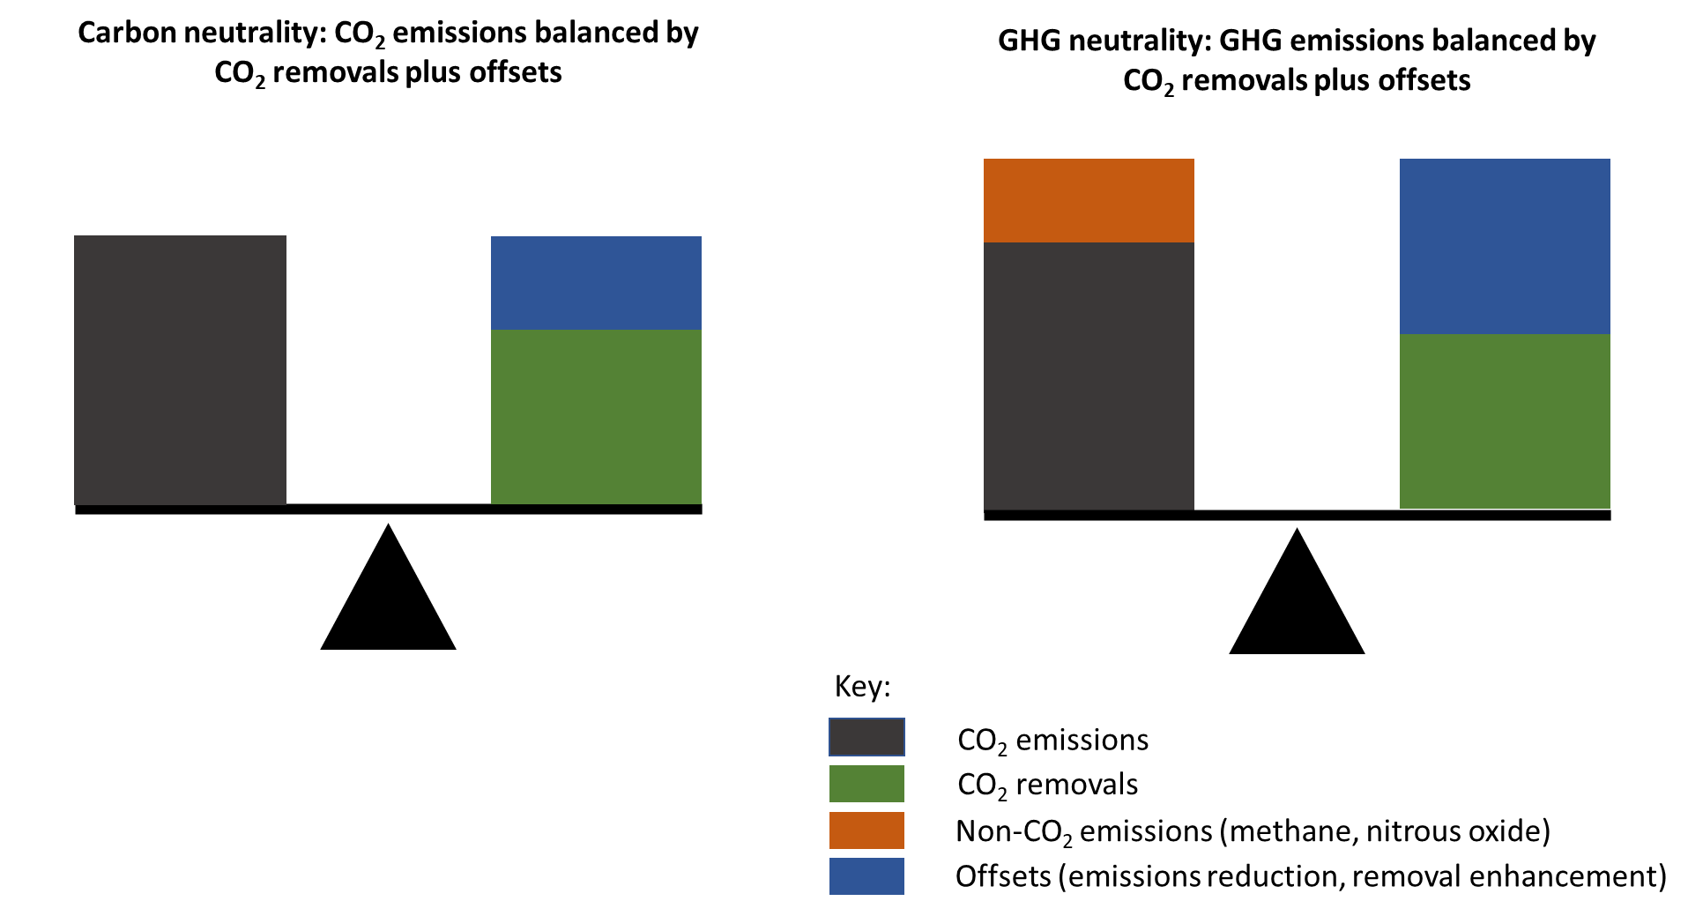
Carbon Farming and Carbon Neutral
Carbon Farming
  Management principles that minimise GHGe, maximise carbon sequestration in the landscape, while improving the productivity and resilience of agricultural systems
    Australian bi-partisan definition
Carbon Neutral or Net Zero
  Management that minimises GHGe, and offsets the balance of emissions through sequestration of an equivalent amount of carbon dioxide in soils or vegetation
    On an year-by-year basis
Climate Neutral
  No net change in global warming
    Net zero long-lived gasses
    <47% less methane by 2050

Slide 21
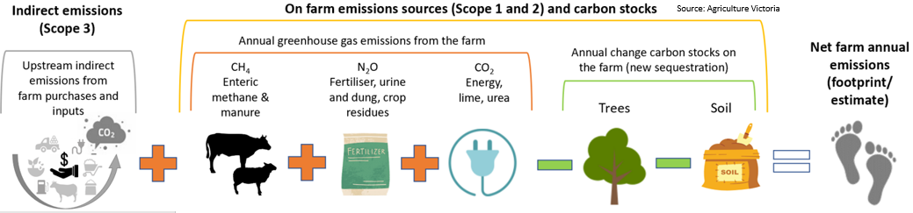
Carbon Accounting: the concept
Source: Agriculture Victoria

Slide 22
Carbon Footprint vs Carbon Account
Carbon account/audit (CA)
    Net Emissions (NE = t CO₂e/ business unit)
  All GHG from boundary of the farm enterprise
  Annual change in soil and tree carbon
Carbon footprint (CF)
    Emissions intensity (EI = t CO₂e/t product)
  Same method as CA
    ISO 14067 - Carbon footprint of products
    ISO 14040 - Life Cycle Assessment (pre-farm to farm gate)
Source: Agriculture Victoria

Slide 23
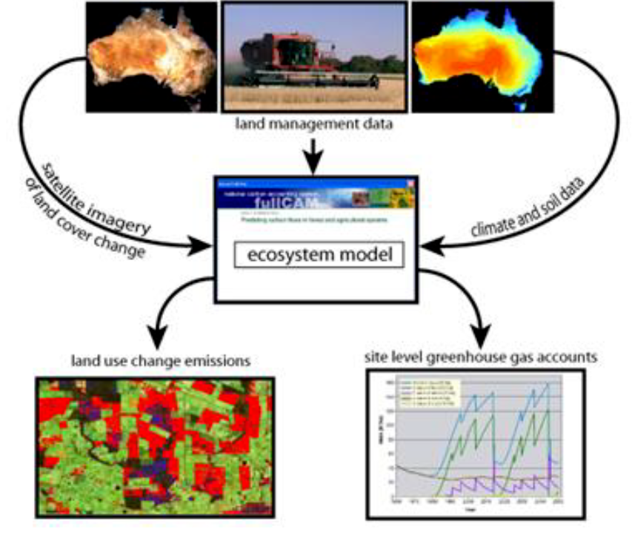
Carbon accounting tools
Greenhouse gas emissions
    Sheep & Beef (SB-GAF)
    Cropping (G-GAF)
    Dairy (D-GAF/DGAS)
    Feedlot, Pork, Poultry
    Buffalo, Deer
    Sugar, Cotton, Horticulture
Carbon stocks and fluxes
  Direct measurement and/ or
  Model
    Soil carbon (FullCam/ FlintPro / Socrates)
    Vegetation carbon (FullCam / FlintPro/ Looc-C)
www.piccc.org.au/Tools

Slide 24
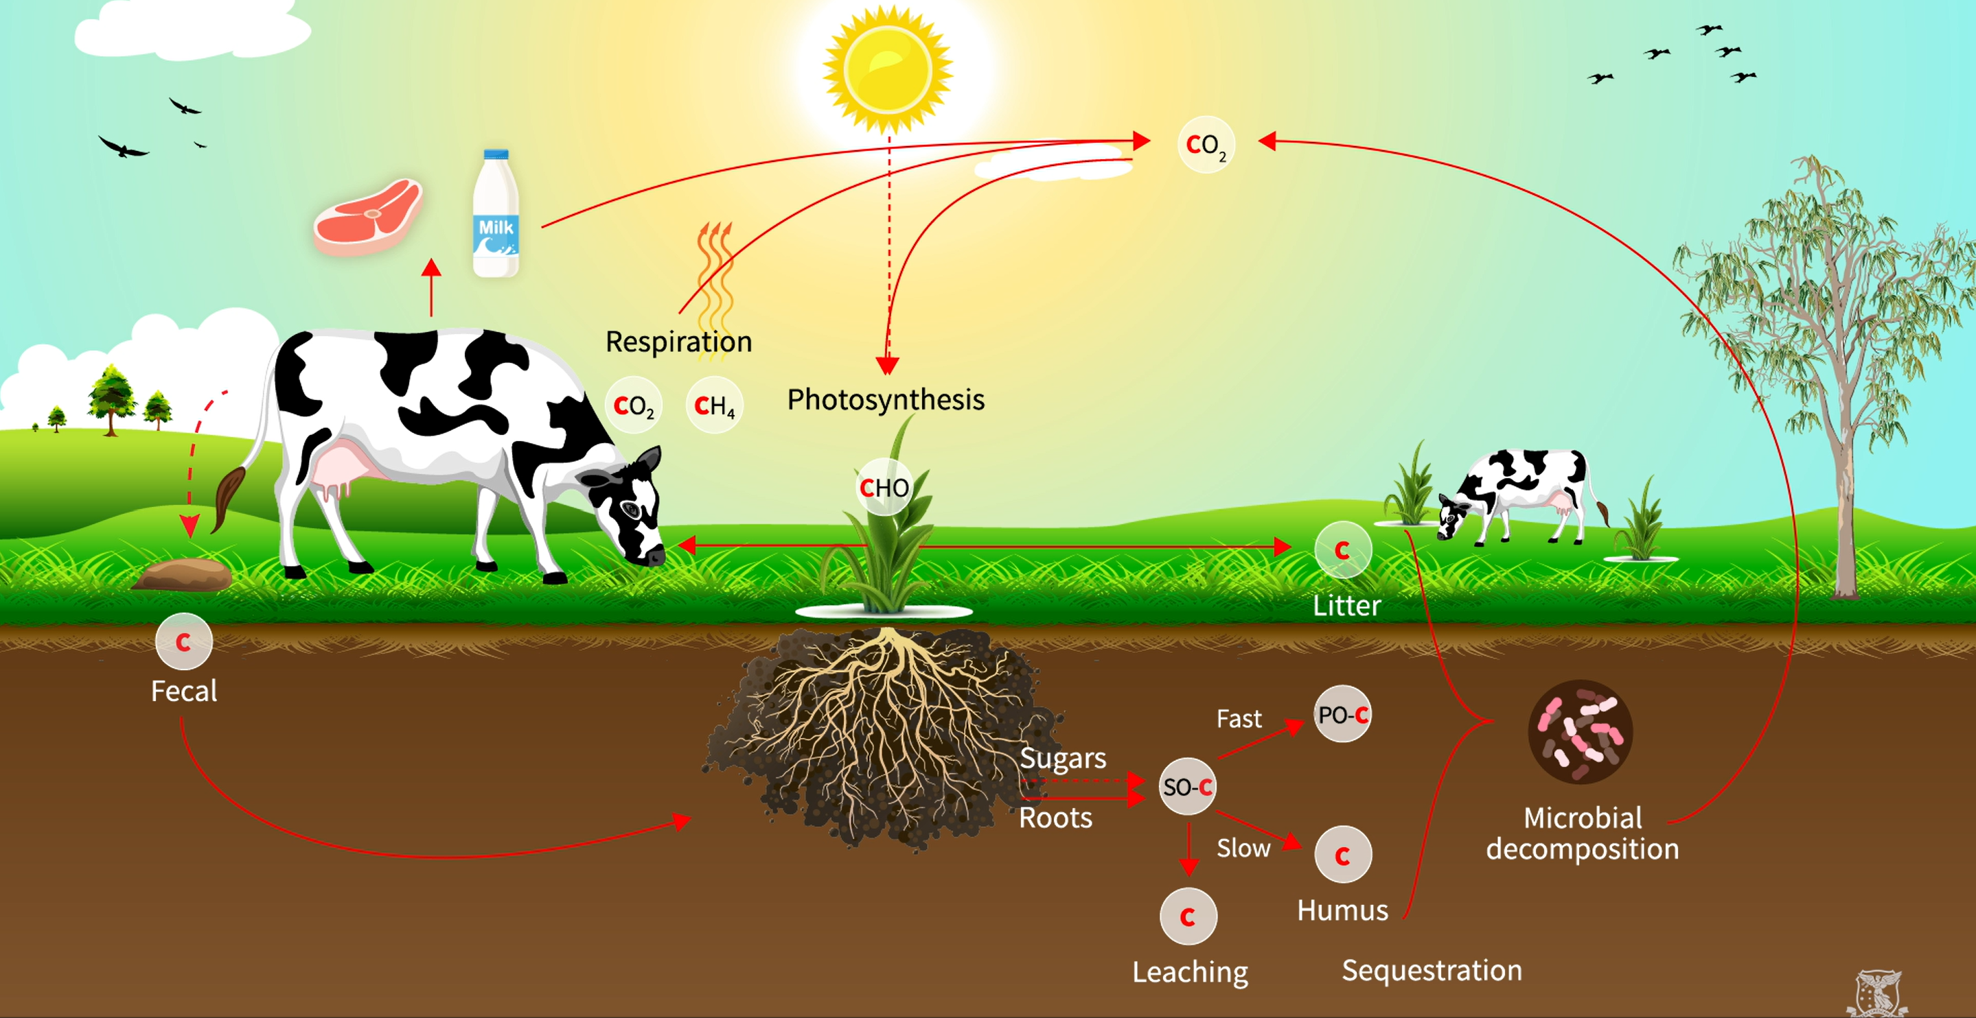
The carbon cycle in agriculture
Meat (60-100 kg C)
Wool (1-2 kg C)
Milk (2-3 kg C)
5 - 20 t C
Sheep 4-8 kg C
Cattle 40-120 kg C
1 - 7 t C
0.5 - 5 t C
0.3 - 4 t C
1 - 5 t C
0.03 – 0.25 t C
Mineral
Assoc C

Slide 25
What are the challenges and opportunities to reduce livestock emissions?

Slide 26
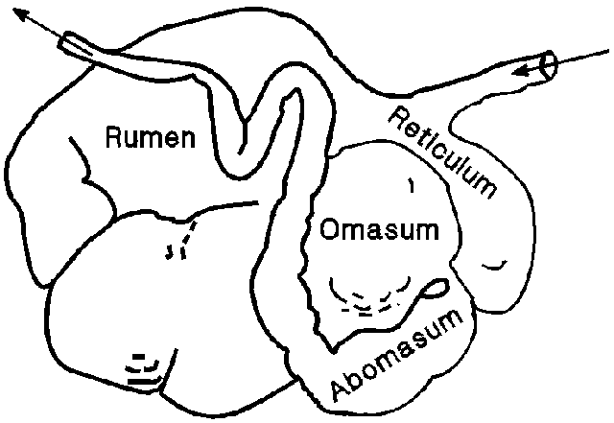
Methane from animal production: rumen digestion
Ruminants evolved 4 stomachs about 50M years ago
  We aim to change this in 30 years
  Adaptation to mitigants is a challenge
Rumen = microbial fermentation
  40-60% bacteria & protozoa
    10¹¹ & 10⁶ cells/ml over 200 species
  5-10% fungi
    10⁶ zoospores/ml
  3% Archaea (methanogens)
    10⁸ cells/ml
Hackmann & Spain (2010)

Slide 27
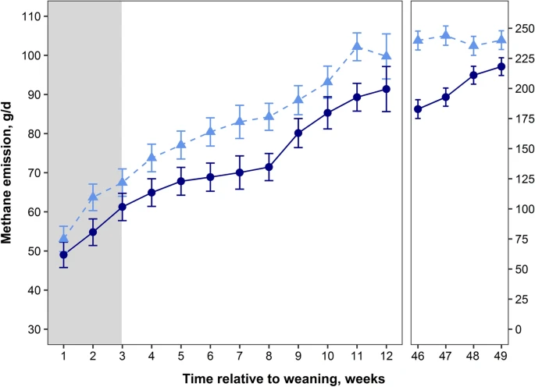
Summary of options for reducing enteric methane
Do Now
Do in 5-10 years
Management (10%)
  Efficiency, health, fertility
Legumes (10-15%)
  Leucaena, Lucerne, Vetch, Lotus
Supplements (10-20%)
  Oils, tannins e.g. grape marc
  Essential oils e.g. Mootral, Agolin
Animal Breeding (1%/yr)
Vaccine (20%)
Methane inhibitors (40 ->80%)
  Asparagopsis
  Bovaer® / 3-NOP
Early life programming
Charmley et al. 2016; Grainger et al. (2009); Moate et al. (2011; 2014; 2016); Williams et al. (2019); Van Nevel and Demeyer (1996); Machado et al. (2014); Li et al. (2018); Eckard and Clark (2018); Li et al. (2018), Meale et al. (2021)

Slide 28
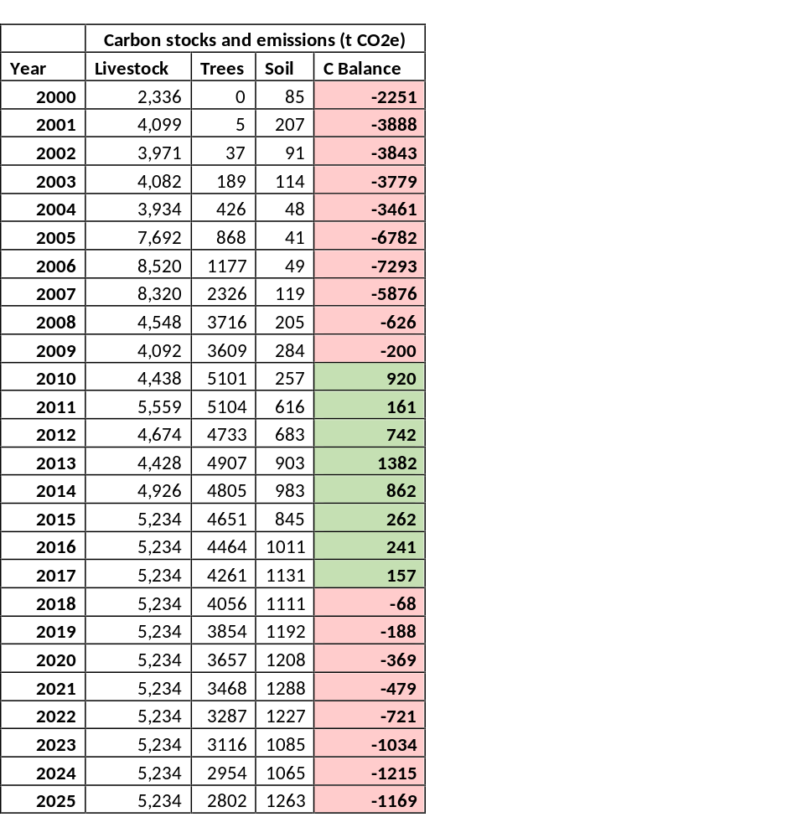
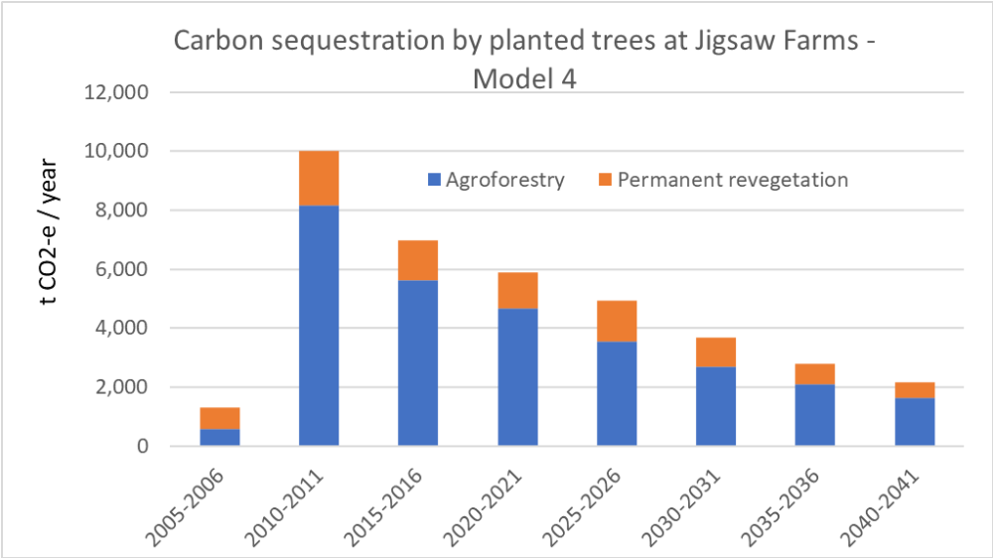
Carbon neutral case studies: Jigsaw Farms
Can we just plant trees?
2018 Study
2023 Study
Emissions/sequestration | t CO2-e/year
Total scope 1 and 2 emissions | 8,640
Total tree sequestration | -7,112
Net GHG balance | 1,528
 | 82% towards net zero

Slide 29
Soil carbon on Jigsaw
Most of the gains have been made by 2008

Slide 30
Three important steps for industry
Know your baseline
  A basic farm carbon audit (or at least know what data to keep)
    Supply chain targets are NOT requiring your farm to be zero by 2030
Plan the first steps
  Start with the ‘Do-now’ / no-regrets strategies
  Trees and soil are only short-term carbon options
    But the co-benefits are long-term!
Carbon credits trading vs low carbon (cannot do not both!!)
  Get independent advice
  You may need to INSET all your carbon access your supply chain after 2030!

Slide 31
www.piccc.org.au
+ piccc.org.au/Tools
+ piccc.org.au/education/carbonneutraltraining
© Copyright The University of Melbourne 2008

Slide 32
Carbon neutral or low emissions livestock production
Richard Eckard
Primary Industries Climate Challenges Centre
University of Melbourne

